Slide 1
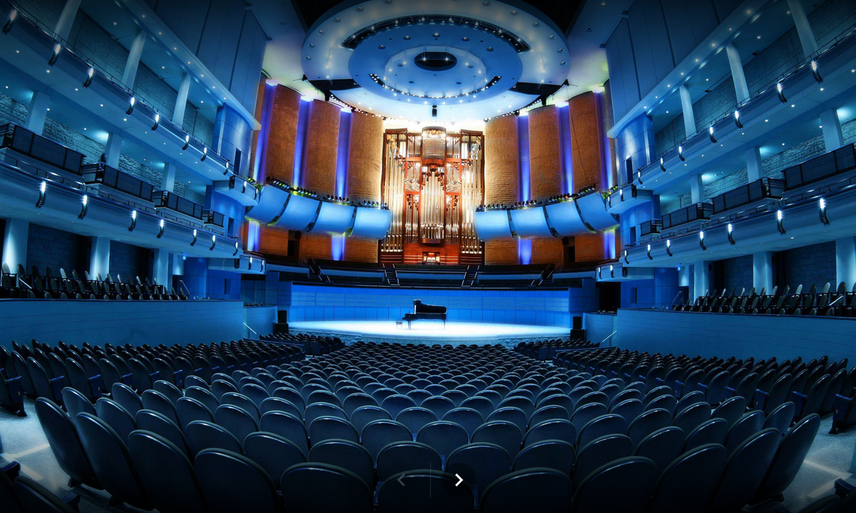
Architectural Acoustics

Slide 2
Looking a bit deeper …
Sound waves in 3D
Wave reflection and transmission
Wave interference and diffraction
How sound behaves in large spaces
Reflection
Absorption
Reverberation
Designing concert halls, listening rooms and other acoustic spaces – some considerations

Slide 3
Sound Reflection, Refraction, Absorption and Diffraction
Always reflect when they encounter a barrier (more precisely and impedance change) and follow the law of reflection: angle of reflection equals angle of incidence
Waves refract (“bend” or change direction) when they enter a medium in which their speed changes
Angles are always measured with respect to the normal or perpendicular

Slide 4
Call of the Loon (and other acoustic illusions!)
Air warms as you get above water surface
Cool air at water surface

Slide 5
The intensity of a reflected sound depends on the absorptivity of the reflecting surface

Slide 6
Example…
A choir in rehearsal in an empty hall produces an average SPL of 85 dB at the middle of the auditorium.
Estimate how the sound will change when the hall is full.
Consider a 500 Hz sound: I = 85 dB, I_{reflected} = (1-0.7)I
So

Slide 7
Controlling Reflections…
More about this when we consider listening rooms and auditoriums

Slide 8
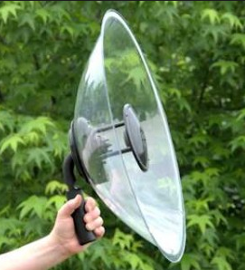
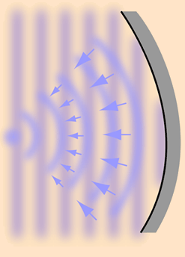
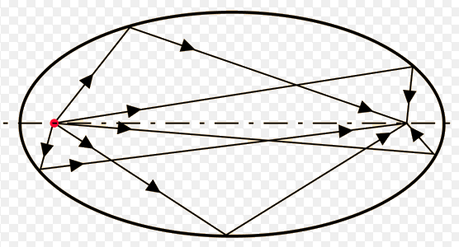
Reflection also depends on SHAPE
Convex shape disperses sound
Concave shape can focus sound

Slide 9
Resonant Modes in Rooms…
l = length, p = mode#
w = width, q = mode#
h = height, r = mode#
Link to a resonant mode calculator

Slide 10
Example….
Let’s find some resonant modes in this classroom…
Ignore the w and h modes for the moment
$f=\frac{v_{s}}{2}\left(\frac{p}{l}\right)$, p = 1,2,3…
L = 10 m; vs = 344 m/s…plug in the numbers
f = 17.2(p) Hz, therefore some resonant modes are…
F = 17.2, 34.4, 51.6, 68.8, 86.1, … Hz

Slide 11
Wave Diffraction and Interference
When waves either reflect or pass through small openings some interesting things happen!
This is why higher frequencies are much more directional than low frequencies

Slide 12
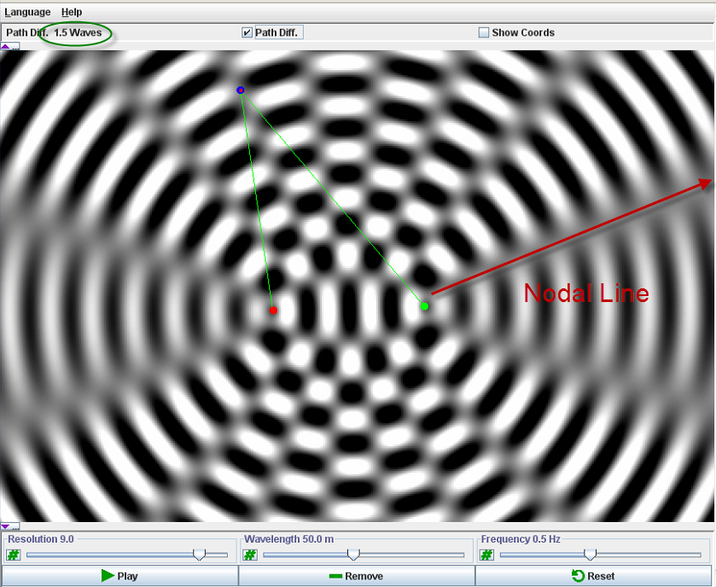
Wave Interference and Path Difference
When 2 waves travel slightly different distances (path difference) to get to your ear this introduces a relative shift in their phase
If the path difference is:
A whole number of waves the waves are still in phase and they add (constructive interference = ANTINODE)
An odd half multiple path difference leads to waves cancelling (destrucitve interference = NODE)

Slide 13
Diffraction Around Edges…
Low pitch sounds spread out more – “bend around corners”
High pitch sounds are more directional

Slide 14
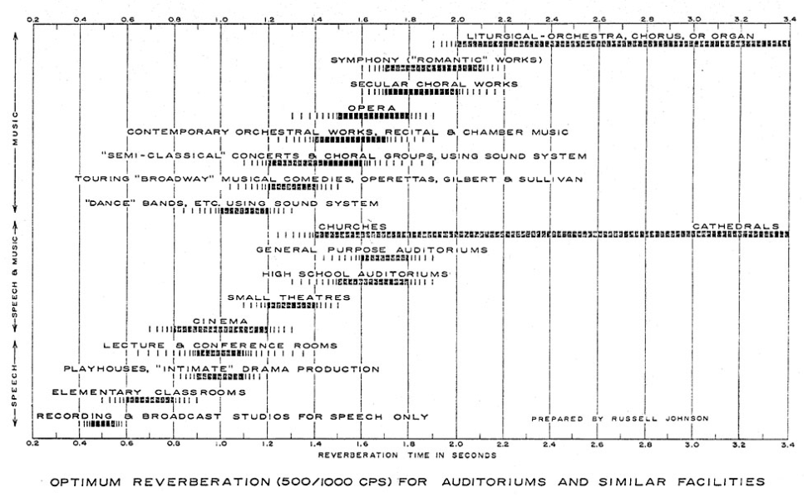
Reverberation
Reverberation time is defined as the time required for a sound level to drop by 60dB
Often this is denoted RT60
Reverberation time depends on room volume and absorptivity/reflectivity of room surfaces
Figure shows “good”RT60 values for various room types

Slide 15
Standards for “Good” Acoustics:
Clarity
little overlap of sounds
Uniformity
sound from all directions
Envelopment
everywhere the same
Smoothness
no echoes
Reverberation
appropriate length of time
Performer satisfaction
reflected to stage
Freedom from noise
no competition

Slide 16
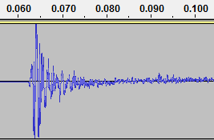
How Calculate and Measure RT₆₀
Wallace Sabine – the Sabine Formula
${RT}_{60}$=(0.16 s/m)$\frac{V}{S_{e}}$
V = volume of room (m³) and S_{e} = effective absorbing area
$S_{e}$=$a_{1}S_{1}$+$a_{2}S_{2}$+$a_{3}S_{3}$+…
Measure RT60 by noting time for a sound level to decay by 60 dB
Sound created by me clapping in my office. Top scale is in seconds

Slide 17
Example – calculate RT₆₀ for this room
Identify how many significant reflective surfaces there are
Determine the areas and absorption coefficients for the surfaces
Apply the Sabine formula

Slide 18
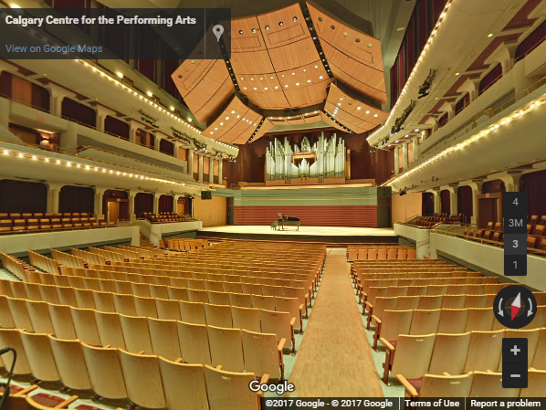
Tour the Jack Singer Hall in Calgary

